Slide 1

DUBAI RESIDENTIAL PRICE PREDICTION

Slide 2
MEET OUR TEAM
JAE ZAKARAUSKAS
JOANNA GROMEK
ZUNYAN GUO​
PETER AUSTIN​

Slide 3
INTRODUCTION
We found a dataset of Dubai Real Estate Transactions via Kaggle.com.
containing 80,000+ housing transactions dated January-June 2023 for Dubai, UAE.
Columns in the dataset include:
amount (in UAE Dirham)
property size (sq.m)
number of rooms
nearest mall/landmark/metro
usage (residential/commercial)
The data contains a lot of transactional data that will enable us to build relations between property median values, median sizes, number of buyers, number of sellers in any given month.

Slide 4

PRE-PROCESSING OF DATA
Agreed on data set to use for the project
Initially started with a total of 22 columns
Collectively reviewed all the data and decided on which information was not pertinent
Decided to initially reduced the data set to ten columns
Cleaned the data using Pandas
Added coordinates in data file for mapping

Slide 5
PREDICTION MODELS

Slide 6
REGRESSION ANALYSIS
Linear Regression Model:
R-squared Score: 0.3899
Lasso Try #1:
R-squared Score: 0.4841
Lasso Try #2:
R-squared Score: 0.6447
Ridge:
R-squared Score: 0.6149
ElasticNet:
R-squared Score: 0.6449

Slide 7
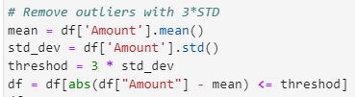
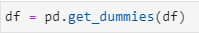
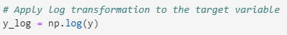
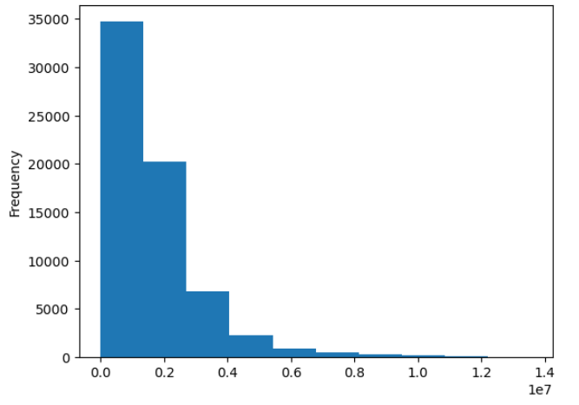
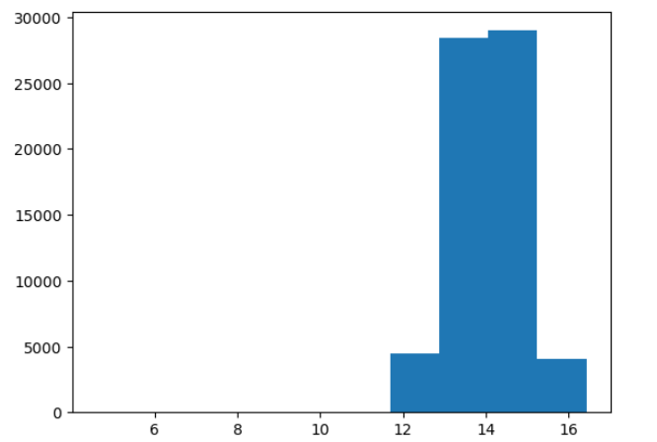
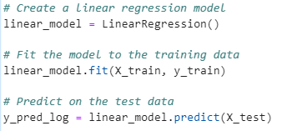
Remove outliers
Convert categorical data to numerical
Data transformation
Build models
Model evaluation: Mean absolute error (MAE), R- squared score, k- fold cross validation.

Slide 8
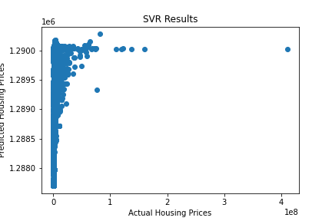
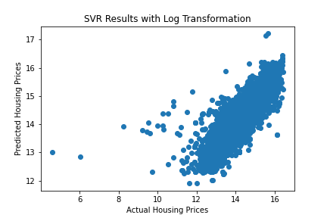
SUPPORT VECTOR REGRESSION
Attempt 2: log transformation applied
R-squared Score: 0.8567
Attempt 1:
R-squared Score: -.02
Notes:
Switching gears here- did some research on different regression models for predicting housing prices and found several articles on support vector regression. SVR handles non-linear regression problems by transforming the data into a higher-dimensional space. The only change I made between the two attempts was log-transforming the data, which clearly greatly improved the performance of the model considering the R SQUARED for the first attempt was a negative value and the second scored a .85

Slide 9
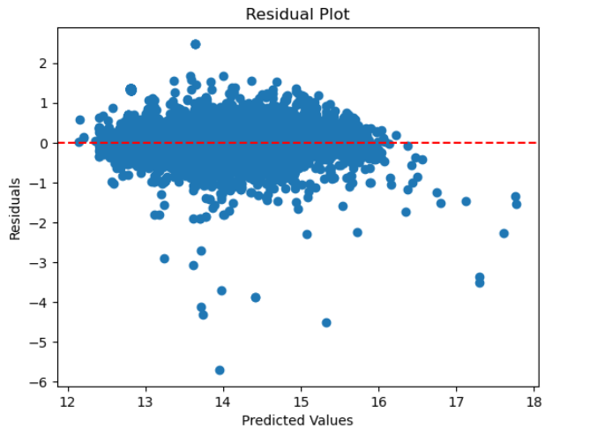
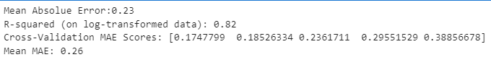
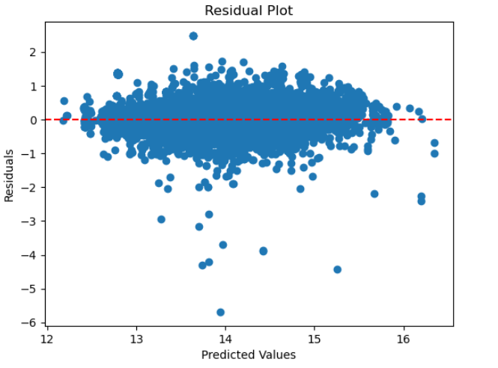
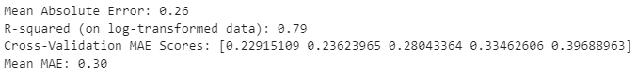
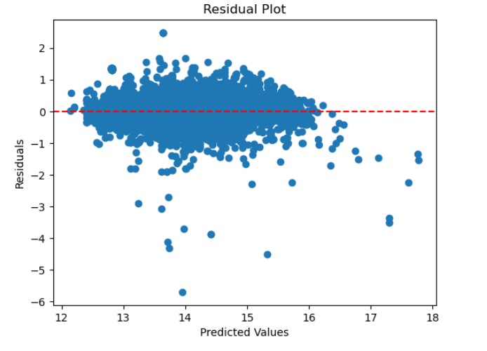
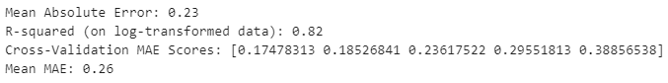
Linear regression model
Lasso regression model
Ridge regression model

Slide 10
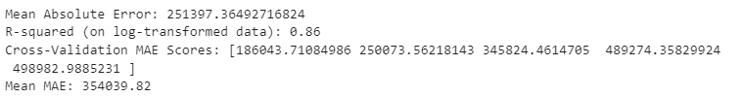
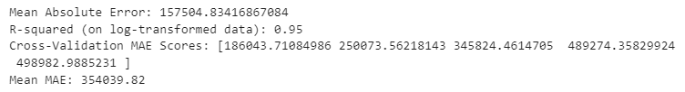
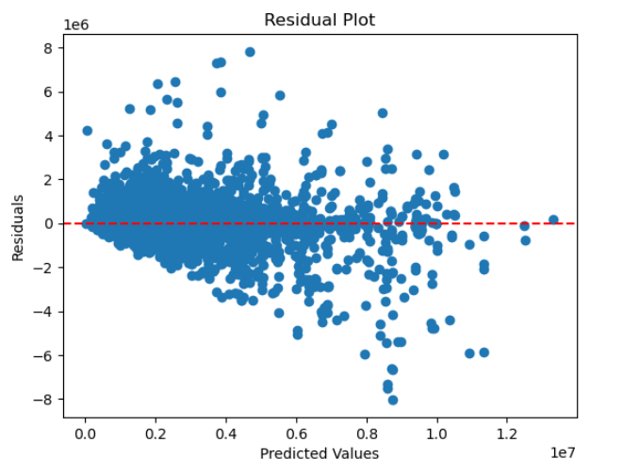
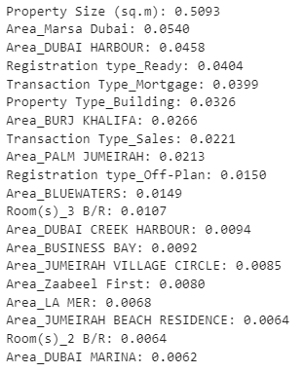
Decision tree model
r2 of training set is a little bit higher than the r2 of test set, slightly overfitting.
Feature importances
The top 5 important features are :
Property size,
Area (Marsa),
Area (Harbour),
Registration type (Ready),
Transaction type (Mortgage)

Slide 11
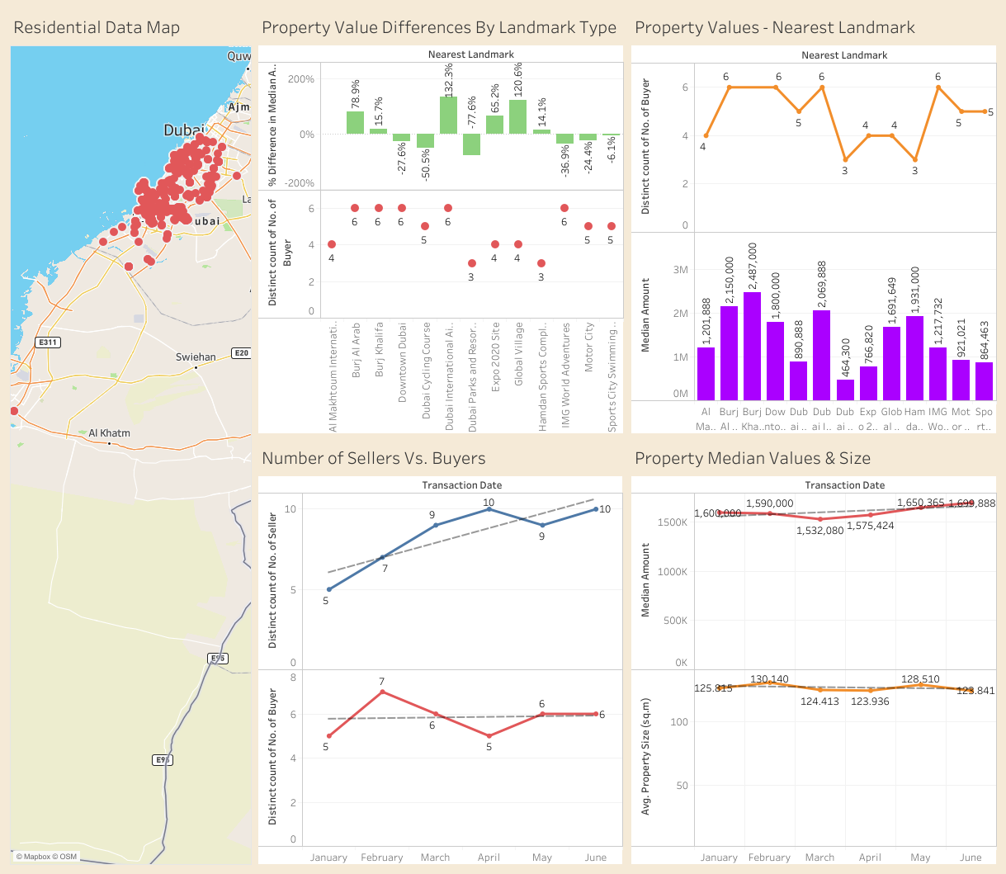
Exchange Rate 1.00 Emirates Dirham = $0.27
Model Outcomes:
Dubai Property Median Price range between 1.5M - 1.7M ($405K -$460K) Dirhams, driven by location (denoted by nearest landmarks) & property sizes
The Burj Khalifa landmark shows the is the most expensive at 2.5M Dirhams ($672K)
Dubai International Airport landmark is third most expensive landmark at 2.1M Dirhams($559K), probably due to high presence of expatriate workers
The model shows some correlation between price ,demand and supply. Buyers per month are highest in the most expensive landmarks( Burj Khalifa, Burj Al Arab & Dubai International Airport) & lowest in landmarks near recreational centers

Slide 12
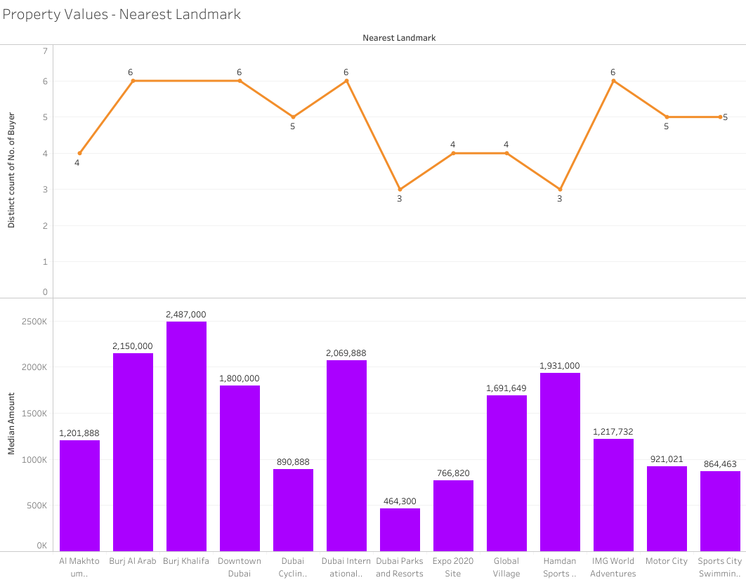
Property Values per Nearest Landmark & Demand (number of Buyers)
Interactive Dashboard is on the Team Github Page
https://jaezak.github.io/dubai_housing_predictions/

Slide 13
CONCLUSION
OBSERVATIONS
Log transformation is important to consider when dealing with data that contains monetary measures.
Data preprocessing is time consuming/difficult to determine which features are important in building a good model.
Decision tree is the best model for predicting our dataset.
R - Squared scores of most models are around or higher than 0.80, which can be considered to be a strong performance.
Other factors other than current actual home prices may influence future prices. Dubai expansion is geographically challenged (desert & ocean).

Slide 14
CONCLUSION
OPPORTUNITIES
Data lacked coordinates for all properties listed.
Given more time, we would have considered creating a website or app that allows users to find housing predictions based on data inputted such as number of bedrooms, size in square meters, etc.

Slide 15
THANK YOU
Instructional Staff (Will, Erin, Andrew, Anki)
Our BootCamp classmates
Project 4 Team

Slide 16
Sources
Predicting House Prices with Support Vector Regression in Python | by Dr. Soumen Atta, Ph.D.
🏠 House Prices Prediction using Random Forest | by Sidharth Pandita | hackerdawn | Medium
https://www.geeksforgeeks.org/house-price-prediction-using-machine-learning-in-python/
https://www.kaggle.com/datasets/austinpowers/dubai-real-estate-transaction-first-semester-2023

